Slide 1

Architecture Breakdown of a Fine-Tuned BERT Model for Sentiment Analysis
Presented By:
Zach Johnson

Slide 2
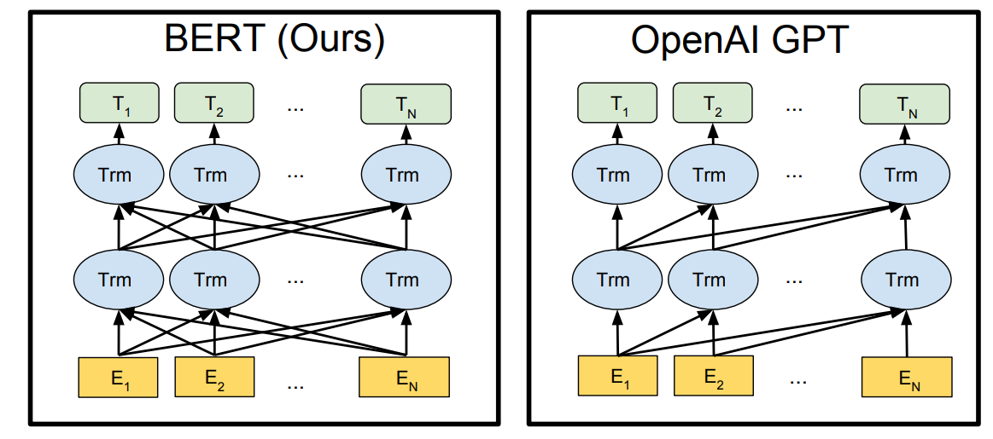
BERT-Tiny
BERT – Bidirectional Encoder Representations from Transformers
Discriminative model (Natural Language Understanding)
Bidirectional Contextualization: considers context of words before and after each word
Built on Transformer Architecture (self-attention)
Contextual understanding makes BERT perfect for Sentiment Analysis
BERT-Tiny
4.3 Million Parameters
2 Transformer Layers

Slide 3

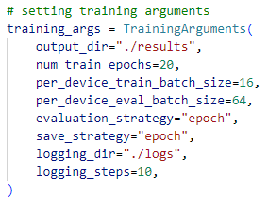
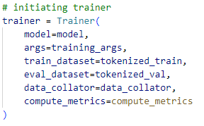

Fine-Tuning for Sentiment Analysis
Dataset: IMDB Large Movie Review Dataset from HuggingFace
50,000 highly polar movie reviews labeled positive or negative
Each movie review is tokenized:
HuggingFace Transformers: TrainingArguments and Trainer
Train!

Slide 4

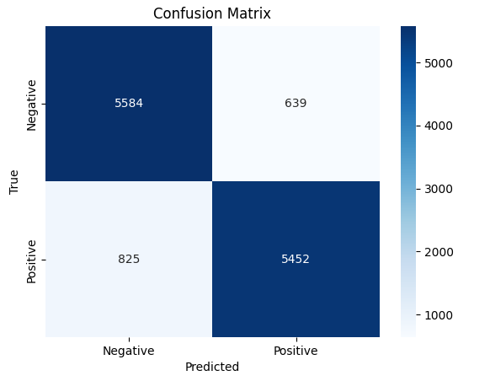
Model Performance
88% accuracy on very small BERT model (BERT-Tiny)
Higher precision (0.895) means positive predictions are usually correct
Lower recall (0.868) indicates more positive reviews are missed
The model is more conservative when predicting positive
Positive reviews that are ambiguous will likely be misclassified as negative
F1 score indicates strong and balanced performance with:
Identifying positive sentiment
Minimizing missed positives

Slide 5
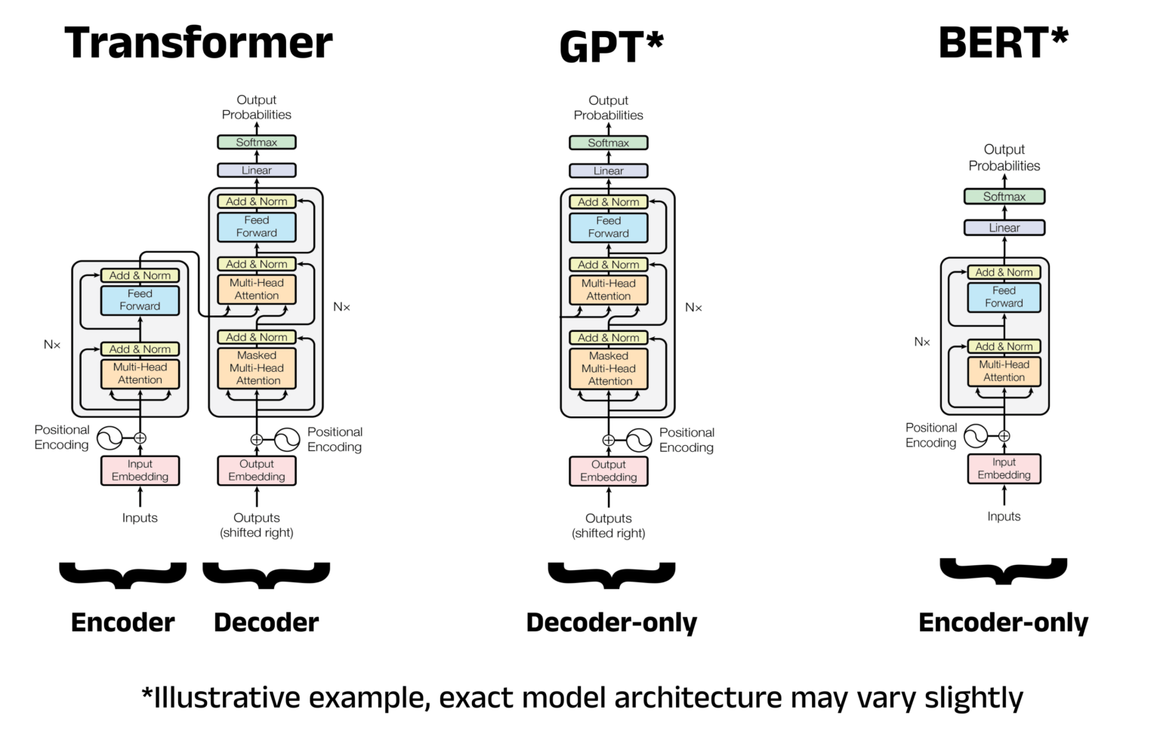

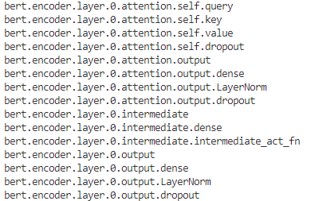

BERT Architecture
BERT uses an Encoder-only Transformer Architecture
Specifically for BERT-Tiny:
Input Embedding Layer
Two Transformer Layers
Classification Head
Fine-Tuned Weights and Biases for each layer can be accessed through HuggingFace Transformer Model:
Goal is to design model entirely from scratch using only matrix multiplication!

Slide 6
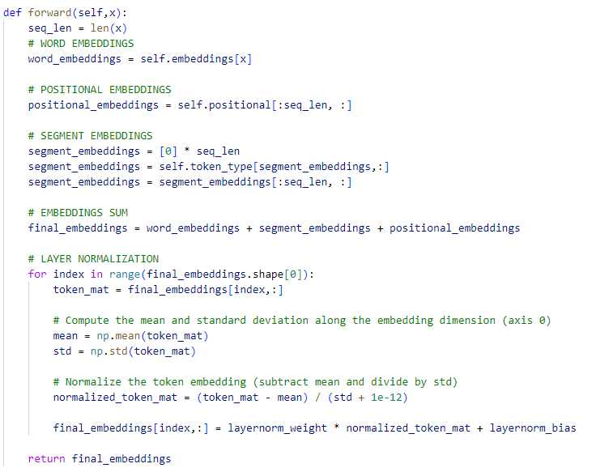
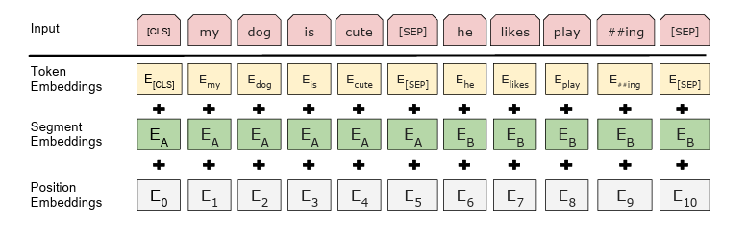
Embedding Layer
Converts input text to vector representations that the model can understand
Considers three embeddings:
Token Embeddings (unique vector for every token in vocabulary)
Segment Embeddings (separates multiple sentences for applications like question/answering)
Position Embeddings (indicates to the model the position of each token in the sequence)
Each embedding is summed together and normalized

Slide 7
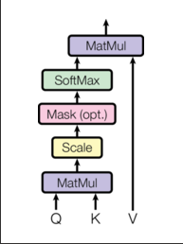
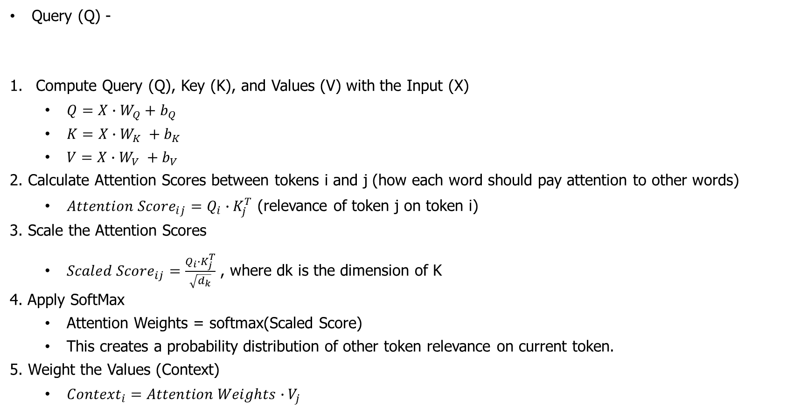
Transformer Layer: Self-Attention
Query (Q) -
Compute Query (Q), Key (K), and Values (V) with the Input (X)
$Q=X∙W_{Q}+b_{Q}$
$K=X∙W_{K} +b_{K}$
$V=X∙W_{V} +b_{V}$
2. Calculate Attention Scores between tokens i and j (how each word should pay attention to other words)
${Attention Score}_{ij}=Q_{i}∙K_{j}^{T}$ (relevance of token j on token i)
3. Scale the Attention Scores
${Scaled Score}_{ij}=\frac{Q_{i}∙K_{j}^{T}}{\sqrt{d_{k}}}$ , where dk is the dimension of K
4. Apply SoftMax
Attention Weights = softmax(Scaled Score)
This creates a probability distribution of other token relevance on current token.
5. Weight the Values (Context)
${Context}_{i}=Attention Weights∙V_{j}$

Slide 8
Transformer Layer: Multi-Head Attention

Slide 9
Classification Head
Model performance after fine-tuning

Slide 10
Why?
Model performance after fine-tuning

